Slide 1

RISK AND RESILIENCY BOOTCAMP
3

Slide 2


Slide 3

The engineering process
In this module, we will
Explore the generic engineering process
Identify the risk and resiliency issues involved in the process
Identify mitigation and recovery strategies
Image credit: https://skefto.com/blog/resilience-strategy-and-risk/

Slide 4
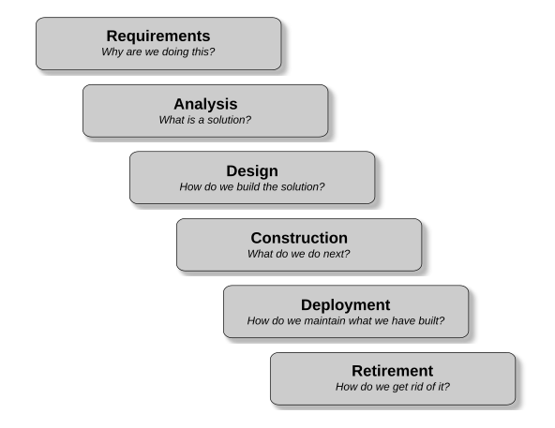
The engineering process
The engineering process is a description of the logical sequence of natural questions or problems as they occur in any kind of construction process
The process is universal and can be observed any time we are successfully building or delivering something in an engineering or business context
This includes software, operations environments, data and IT architecture

Slide 5
requirements
The basic question that has to be answered during requirements is
“Why are we building this?”
This is often called the “value proposition”
Identification of the problem to be rectified

Slide 6
requirements
This is generally followed by two other kinds of questions
“What do the users need the solution we are building to do for them?”
At this stage, we need to know the functional requirements (what the stakeholders expect what we are building to do for them)
And the non-functional requirements (what the performance criteria are that the solution must meet)
“What are the constraints – budget, time, architecture, etc. – that have to be considered when building the solution?”

Slide 7
requirements
It is not always possible to identify all the requirements at the beginning of the project
We may need to use some adaptive methodology like an Agile approach
Iterations help validate assumptions about the underlying problem
And help identify erroneous assumptions about what the requirements are

Slide 8
requirements
“Go to the source of the problem”
Find out what the real requirements are directly from those who have them
Requirements are often supplied second hand
“This is what the people I supervise need.”
Actually “This is what I think my people need”
Identify stakeholders
Groups that have requirements
And the capability to force you to accommodate their requirements
Image credit: https://skefto.com/blog/resilience-strategy-and-risk/

Slide 9
requirements
Primary stakeholders
Impacted directly by the project
Customers, staff, process owners, data owners, budget controllers
Have project specific requirements we can ask them about
Secondary stakeholders
Usually regulate a domain of activity
Data governance, accessibility standards
Do not have project specific requirements
Their requirements are usually published
Non-responsive to inquires (“Go look it up in our publication on the topic”)
Image credit: https://skefto.com/blog/resilience-strategy-and-risk/

Slide 10
requirements
Secondary stakeholders
Often are the source of constraints
IT infrastructure standards
Legal and regulatory compliance
SLAs for that type of project
Business case requirements
Security requirements
Audit and accountability requirements
Image credit: https://skefto.com/blog/resilience-strategy-and-risk/

Slide 11
Analysis
In the analysis phase, we find a solution to the problem
We formulate the solution in a specification that describes what is to be built
The specification serves as a design target
Whatever design we propose must create a product that meets the description of the solution in the specification
We may come up with multiple ways to solve the problem which differ in terms of cost, quality and other factors
But eventually, we need to settle on a single solution
Image credit: https://skefto.com/blog/resilience-strategy-and-risk/

Slide 12
Analysis
Analysis will propose an architecture
Often referred to as a high level design
Identifies major components
For example, the data architecture
It should decompose the system into subsystems
Called a functional decomposition
The specification
Defines what the system should look like and how it behaves
Often with a full set of acceptance tests
Image credit: https://skefto.com/blog/resilience-strategy-and-risk/

Slide 13
Analysis
Comparative analysis
What other similar projects are doing to solve similar problems
The types of outcomes that result
Learn from their mistakes and successes
Historical analysis
What have we tried to date?
What have we learned?
Usually about domain issues
Image credit: https://skefto.com/blog/resilience-strategy-and-risk/

Slide 14
Analysis
Alternatively
We may need to experiment
Small pilots
Experiment with different architectures
Experiment with different interfaces
See if our assumptions were valid
Often requires a detailed knowledge of the domain
Design Thinking
Design Driven Development
Image credit: https://skefto.com/blog/resilience-strategy-and-risk/

Slide 15
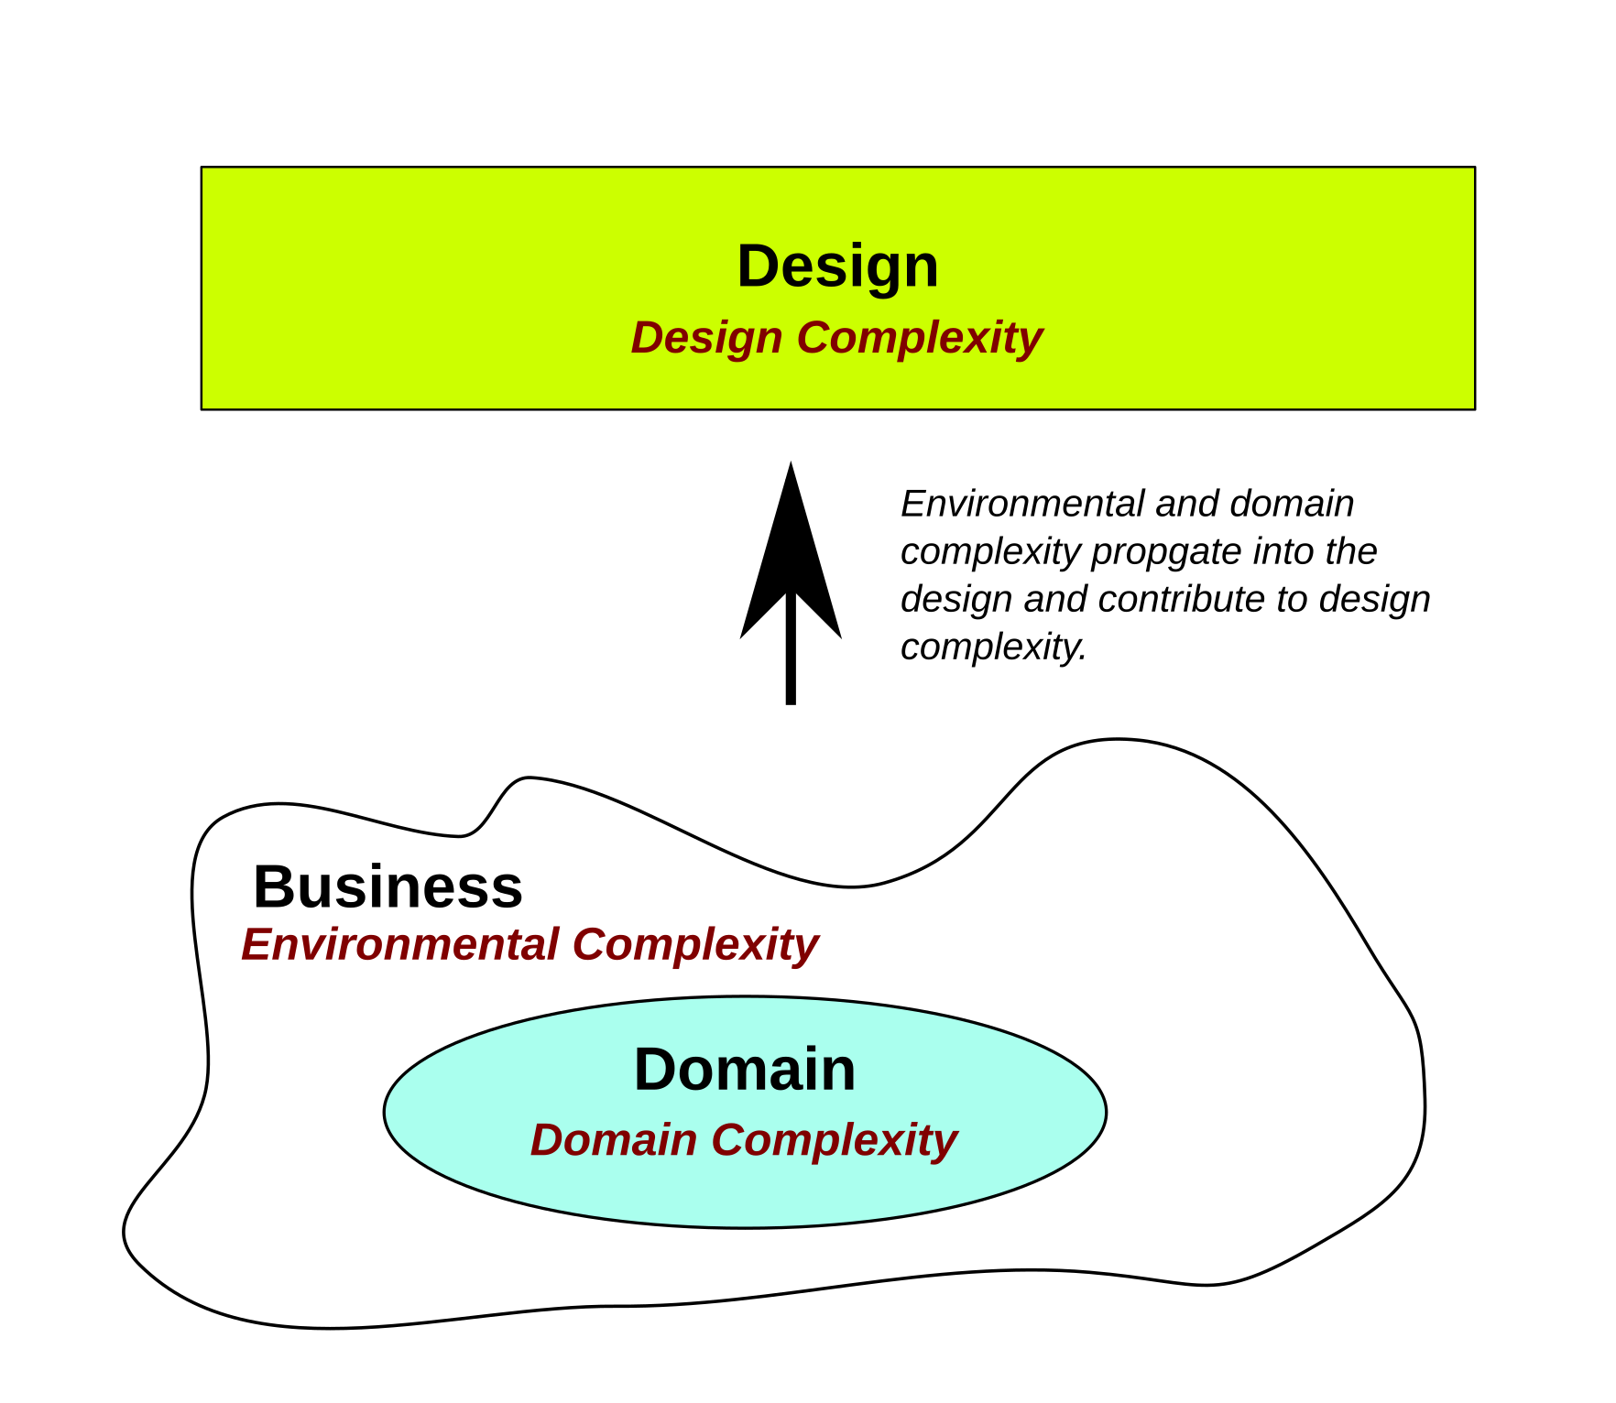
Complexity again
Three kinds of complexity we have to deal with
Domain complexity: trying to automate in a domain that is inherently complex
Design complexity: Designs that are not elegant (simple and effective)
Environmental complexity: Resulting from a disorganized and poorly functioning business
We can eliminate a lot of design complexity with good design and engineering practices
We cannot make domain complexity go away, we can only manage it
Image credit: https://skefto.com/blog/resilience-strategy-and-risk/

Slide 16
Propagation of Complexity
Not properly managed, environmental and domain complexity directly propagate into design
We should not confuse environmental complexity with domain complexity
We cannot deal with it, so we have to ignore it in understanding the domain
The most important single aspect of software development is to be clear about what you are trying to build.
Edsger Dijkstra
First, solve the problem. Then, write the code
Donald Knuth
Image credit: https://skefto.com/blog/resilience-strategy-and-risk/

Slide 17
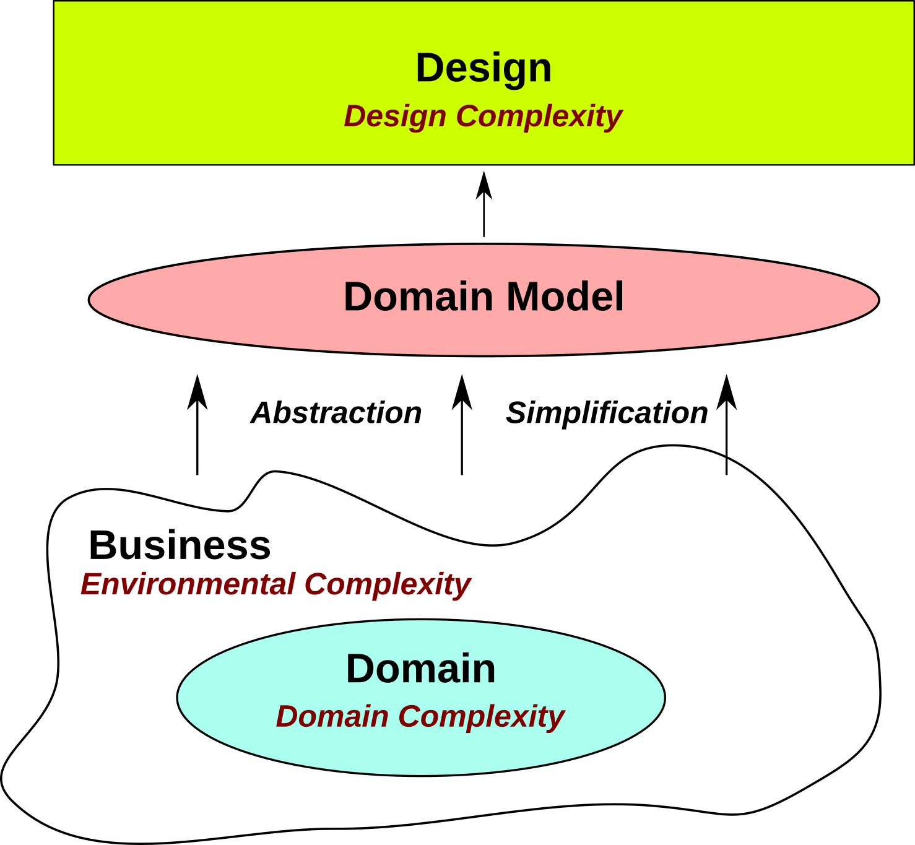
Resolving complexity
When dealing with domain complexity
We extract the essential elements of the domain that are relevant to the problem to be solved
We abstract out what is irrelevant to solving the problem
The resulting domain model is a simplification of the problem domain that retains all the critical information
Image credit: https://skefto.com/blog/resilience-strategy-and-risk/

Slide 18
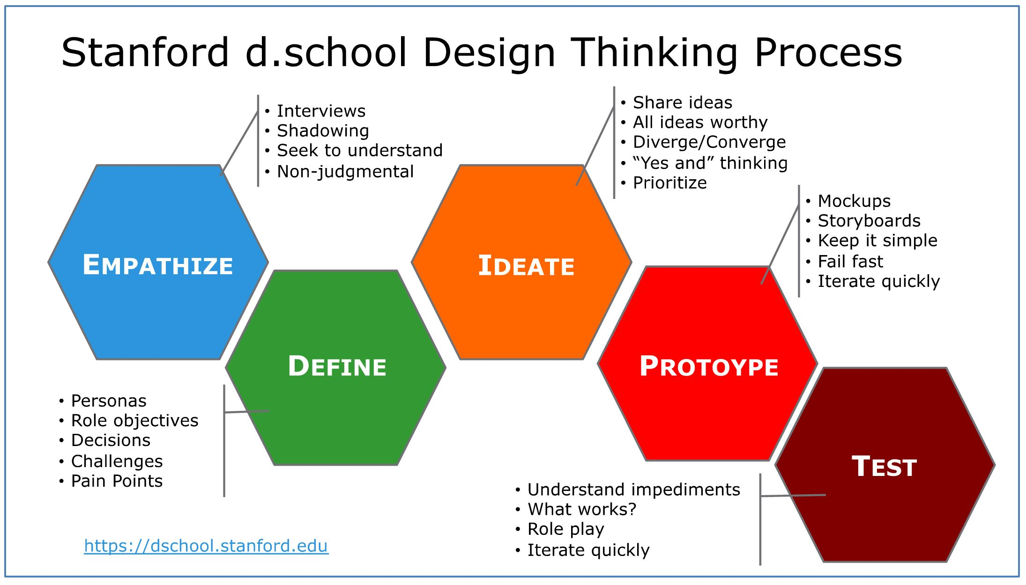
Design thinking

Slide 19
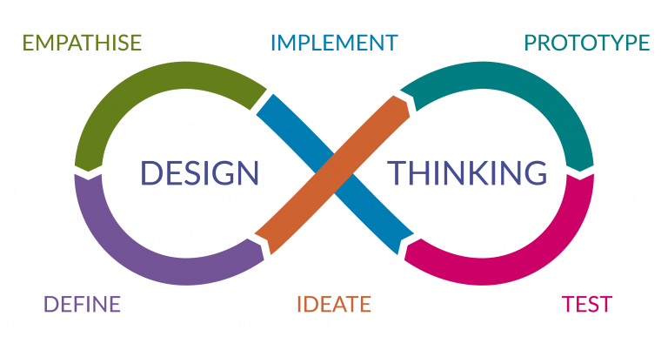
Design thinking

Slide 20
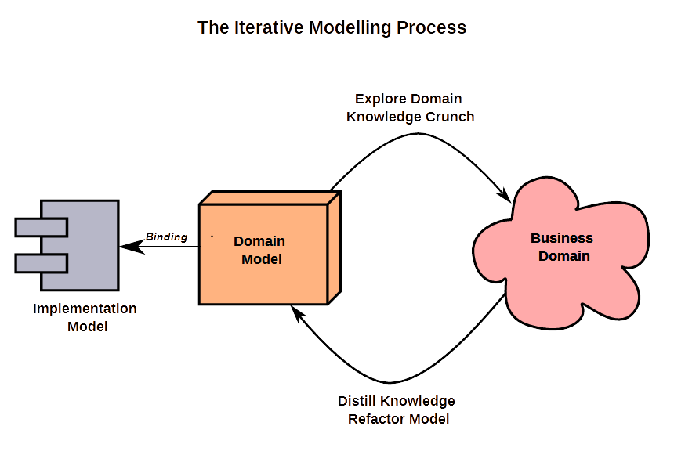
Knowledge crunching
Key idea
Successive deep dives into the problem domain
Understand concepts and relationships in the domain
Work from the perspective of the domain experts
Collaboration with SMEs
Refine the domain model with insights
Do it again
c
Image credit: https://skefto.com/blog/resilience-strategy-and-risk/

Slide 21
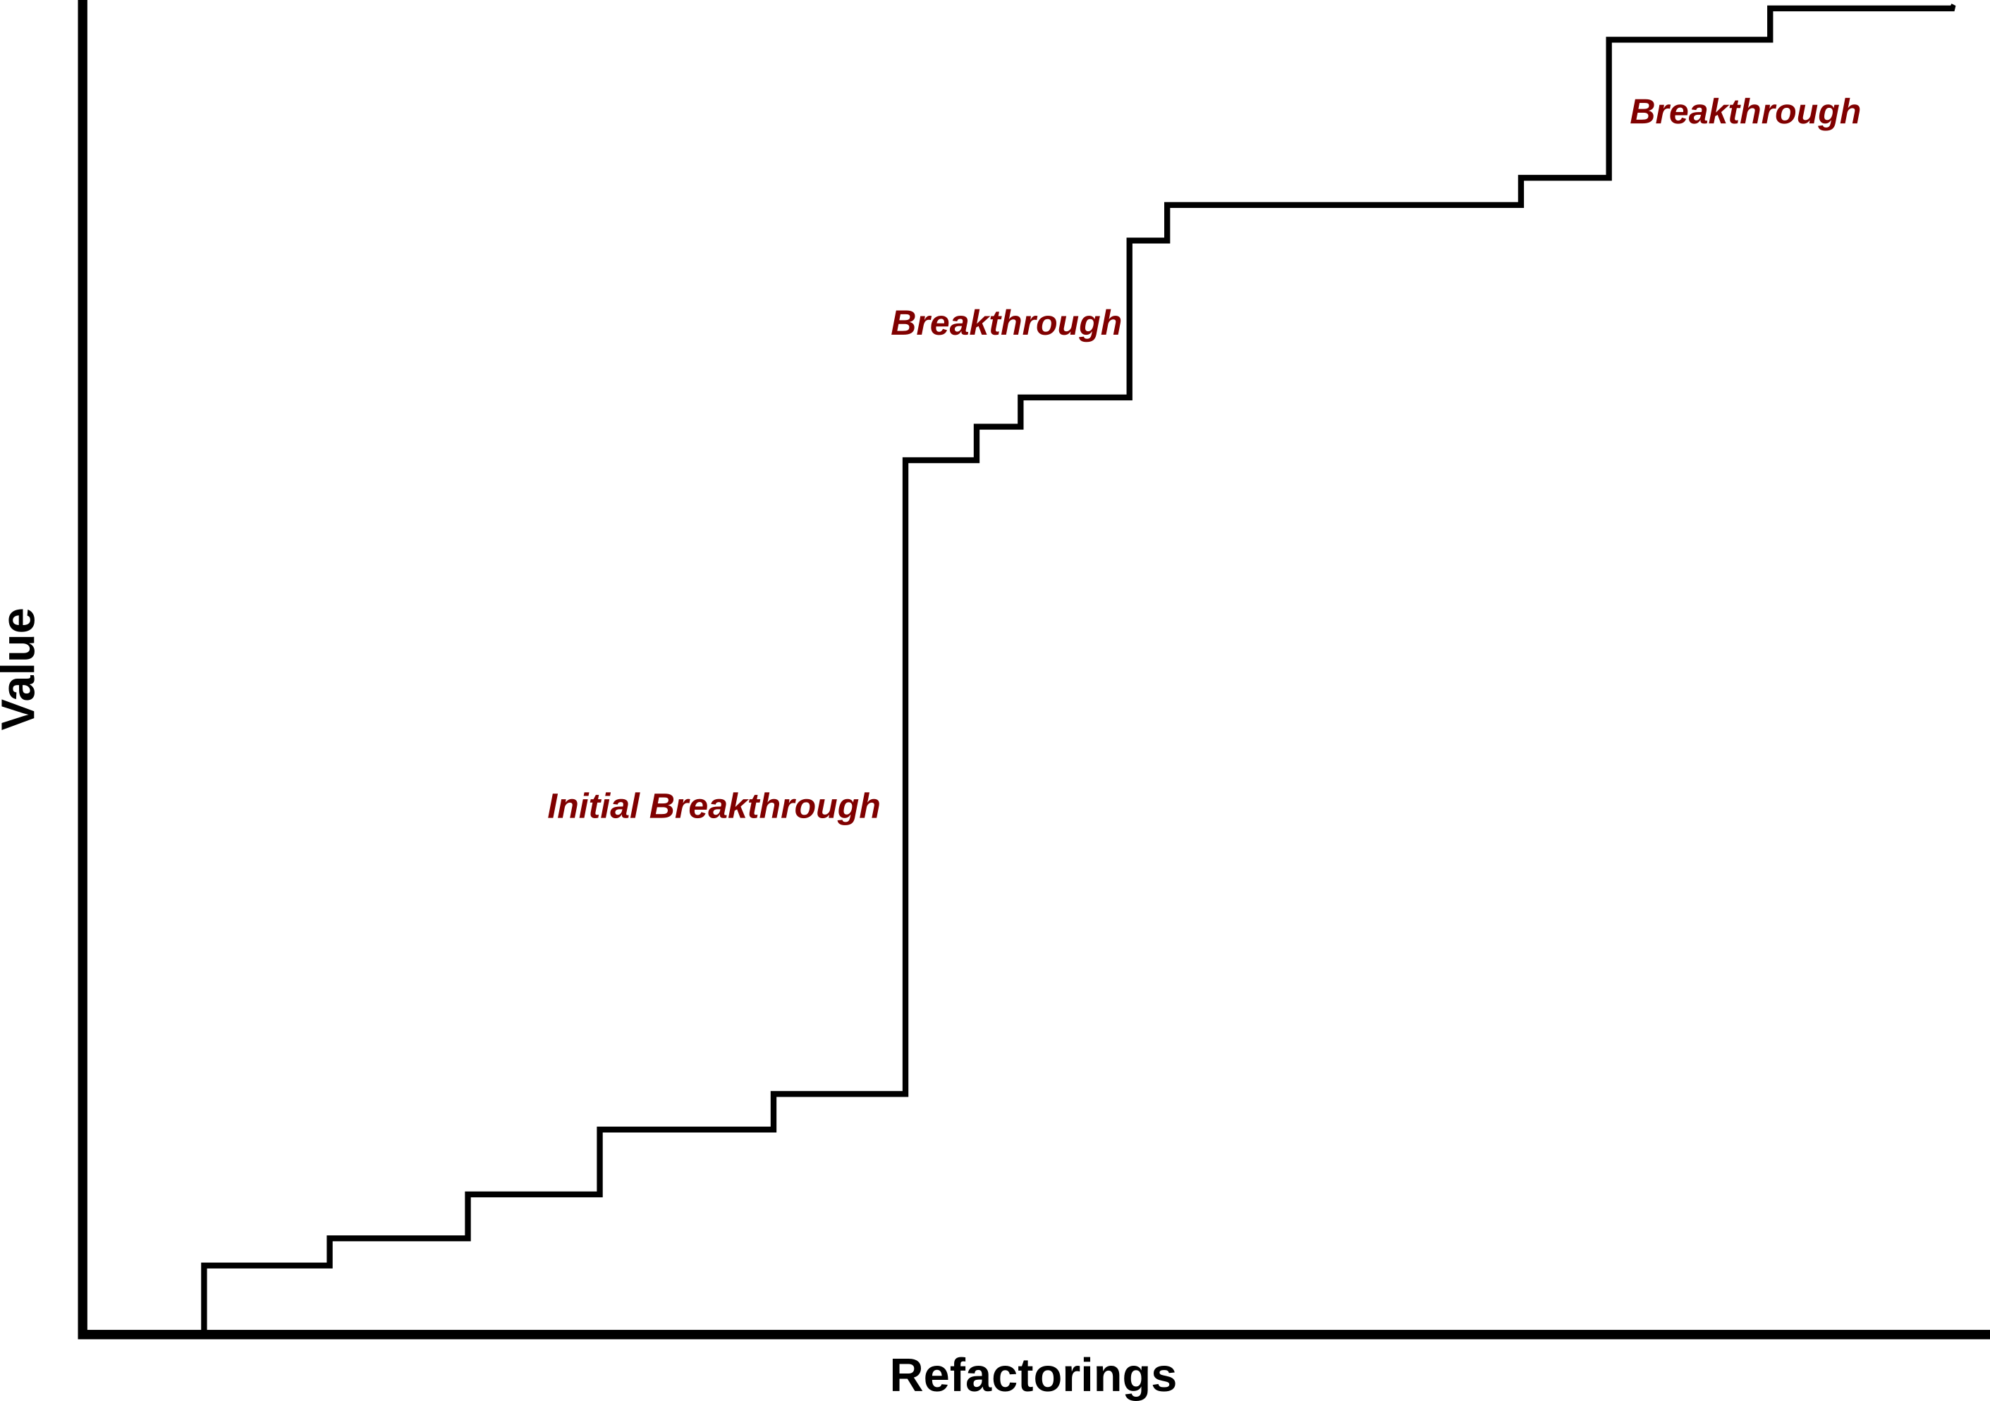
Resolving complexity
Breakthrough iterations
Happen when we get sudden new insight into the domain
Often results in a simpler and more powerful model
Closely related to design thinking
Image credit: https://skefto.com/blog/resilience-strategy-and-risk/

Slide 22
The spec
The specification is often called the SRS (software requirements specifications) document
An SRS is the basis of a complete and unambiguous communication of information between all the different parties involved in systems development
The basis for this section is the IEEE standard “Best practices for software requirements specifications”
The intent, as noted by the IEEE, is to
Establish the basis for agreement between the customers and the suppliers on what the software product is to do
The complete description of the functions to be performed by the software specified in the SRS will assist the potential users to determine if the software specified meets their needs or how the software must be modified to meet their needs

Slide 23
The spec
Reduce the development effort
The preparation of the SRS forces the various concerned groups in the customer's organization to consider rigorously all of the requirements before design begins and reduces later redesign, re-coding, and retesting
Careful review of the requirements in the SRS can reveal omissions, misunderstandings, and inconsistencies early in the development cycle when these problems are easier to correct
Provide a basis for estimating costs and schedules
The description of the product to be developed as given in the SRS is a realistic basis for estimating project costs and can be used to obtain approval for bids or price estimates
Provide a baseline for validation and verification
Organizations can develop their validation and verification plans much more productively from a good SRS
As a part of the development contract, the SRS provides a baseline against which compliance can be measured
Facilitate transfer
The SRS makes it easier to transfer the software product to new users or new machines
Customers thus find it easier to transfer the software to other parts of their organization, and suppliers find it easier to transfer it to new customers

Slide 24
The spec
Serve as a basis for enhancement.
Because the SRS discusses the product but not the project that developed it, the SRS serves as a basis for later enhancement of the finished product
The SRS may need to be altered, but it does provide a foundation for continued production evaluation
Properties of a good spec
These are listed in table on the next slide
These are considered the essential features of a spec that reduce the risk of errors creeping into the development process

Slide 25
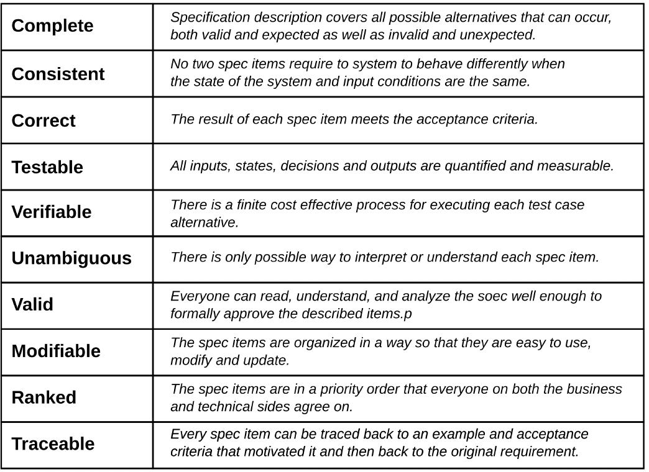
The spec

Slide 26
design
A specification describes a solution but does not tell us how that solution should be built
A design describes how the solution is to be built given a specific set of resources, capabilities and constraints
For a single specification, we may have several different designs depending on what we have available to work with
Early prototypes during Analysis
Will have a putative design
Lightweight; more of a plan for experimentation

Slide 27
design
A Design
Can be thought of as the project plan
Defines an application architecture
Defines the components and how they interact
Defines the QA requirements and baselines
DevOps approach
We also define the automation CICD pipelines that will be used
We design the dev and ops infrastructure as part of the design
Includes the monitoring, continuous evaluation and feedback
Also any supporting data engineering

Slide 28
construction
The product described in the specification is built according to a given design and construction or project plan
Having a design alone is not enough for something to be built
Especially as the size and complexity of what you are building increases
We may also need to build the development infrastructure
You also must use the appropriate construction techniques and plan out the development activities
This is where the actual programming takes place

Slide 29
deployment
The completed solution is deployed when it goes into use
The questions that we have to ask in the deployment phase deal with operational issues such as:
“How are changes or repairs to be made?”
“How are users and maintenance people to be trained?”
“How do we monitor the product for possible malfunctions?”
“How do we monitor the level of performance in terms of expected SLAs?”

Slide 30
deployment
If we are using a DevOps process
We will use some sort of staged deployment
In both production and prototypes
Several basic types
Canary deployment
Blue/Green deployment
A/B deployment
Rolling deployments
Preferably automated
Each allows a roll-back path
In case the deployment goes bad, we can immediately roll back to the previous deployment

Slide 31
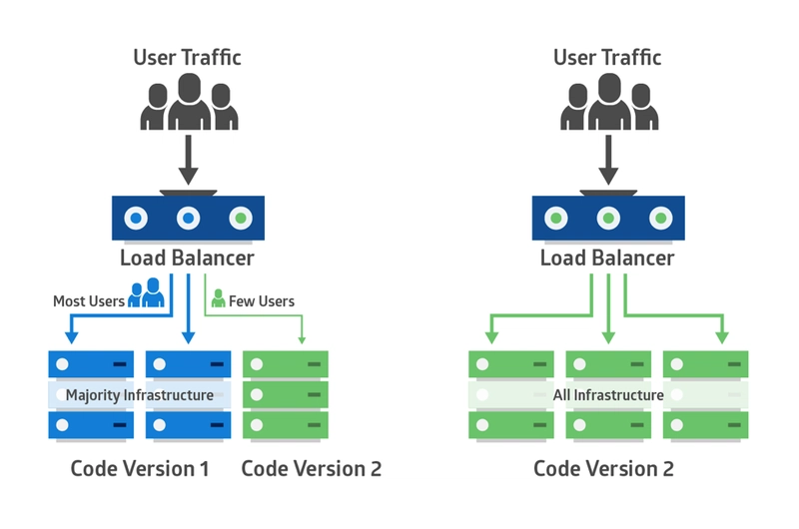
Canary deployment
Intended to evaluate risk
Application is deployed in a small part of the production infrastructure
Only a few users are routed to it
This minimizes any impact of problems from the new deployment
Performance of the canary is monitored
Evaluate performance against SLAs and KPIs
Evaluate performance against the non-canary deployment
If standards are met, more users are routed to the canary
The non-canary is left intact in case we have to roll-back during deployment

Slide 32
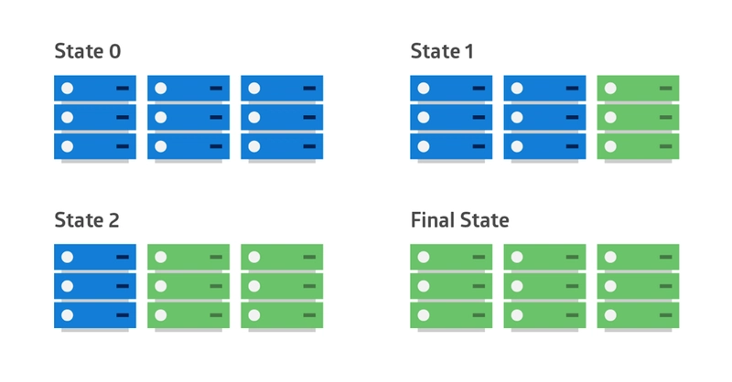
Rolling deployment
Often used to control issues with scale
Different rollout targets are identified
Operational units or regional units
As each unit is updated, the overall performance is monitored
Scale issues
The application may be working locally
But when scaled up, starts to underperform
A common cause is overloading the infrastructure that supports the application

Slide 33
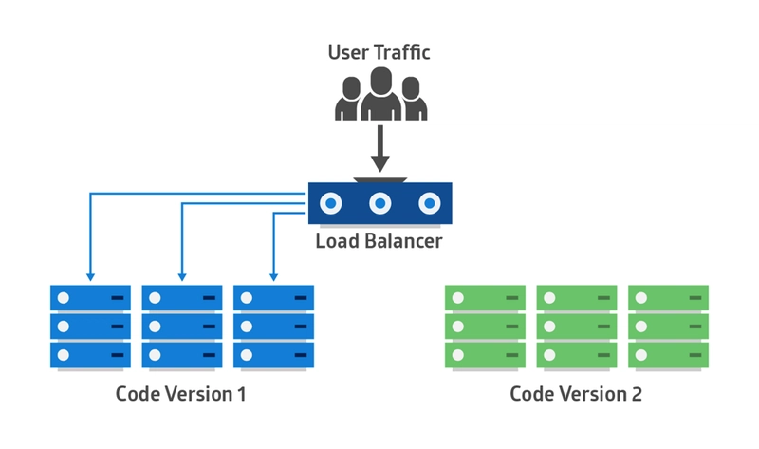
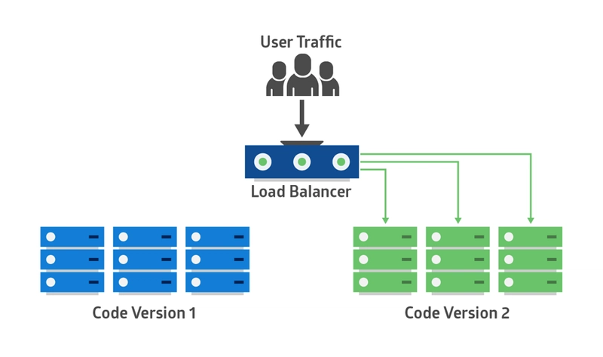
blue/Green deployment
Similar to a rolling deployment coupled with a canary deployment
Not as risk sensitive as a canary deployment
How it works
The new version of the application is deployed in the green environment and tested for functionality and performance
Once the testing results are successful, application traffic is routed from blue to green.
Green then becomes the new production
If testing fails, we can switch back to blue
Eventually blue version is archived
Usually used for upgrades to an application

Slide 34
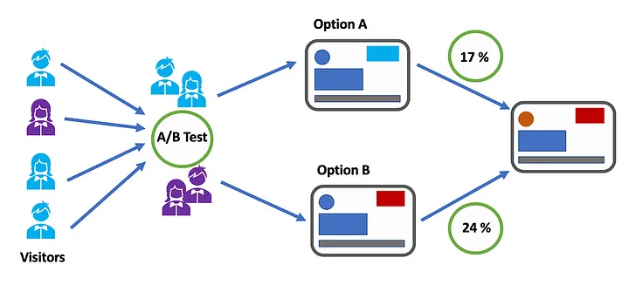
A/B deployment
Used to test two different alternatives
Some users are routed to version A and some to version B
Then the performance of each version can be compared
For example, a decision support tool using two different user interfaces

Slide 35
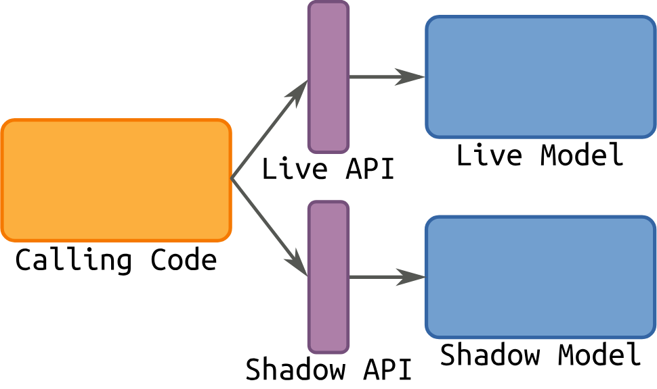
shadow deployment
The new application is deployed in parallel with the existing system
All requests are still handled by the existing system
They are also routed to the new app which is shadowing the existing system
Outputs of the shadow deployment are compared with the existing system
Ensures that the shadow system works to spec before it replaces the existing system

Slide 36
deployment
Prior to deployment, KPIs and SLAs need to be established
Some of these are performance based
Often collected and evaluated with automated tools
Some of these are acceptance based
Requires gathering feedback from users of the application
Some of these are correctness or value based
Are we getting the right results?
May require a manual review

Slide 37
Retirement
All products and systems have to be taken out of service at some point
Whether it's a nuclear reactor, a make of car or a software application
How we move the product out of the production and replace it, if necessary, with its successor
Issues we have to consider are:
Business functional continuity
Data continuity
Transfer of functions to new services
We often need to plan for retirement from the earliest stages of the project

Slide 38
Retirement
Retiring the application is a governance decision
Do we replace it or upgrade it?
As part of our initial design
We should have included a retirement facility
An “un-rollout” strategy for a staged phase out
Including a potential migration path for data and other artifacts to another system
Preservation of whatever is needed for records compliance or legal compliance

Slide 39

Q&A and open discussion
Notes:
Now is the time to engage in an interactive Q&A session where you can ask questions, share insights, and clarify any doubts about the topics we have covered so far.
This open discussion is designed to ensure that every participant has the opportunity to voice their thoughts and learn from the collective experience of the group.
Your questions and comments are valuable as they help us identify areas that may need further explanation and enable us to tailor future sessions to your needs.
We encourage you to speak up and contribute to the dialogue, as this interaction is one of the key components of our interactive learning approach.
As the session progresses, take note of any questions or ideas that you would like to revisit, and feel free to share your perspectives with the class.

